Slide 1
Better jobs for mums and dads

Slide 2
Introduction
Methodology
The project comprised qualitative and quantitative research with young (aged 35 and under) working parents, all of whom had a combined household income of £28,000 or less
Stage 1: Qualitative
Dec 2016 – Jan 2017
2-week diary tracking task to capture the experiences of parents, without influencing their stories
8 x 2 hour focus groups designed to understand their experiences, the role of their employers and their responses to the existing and amended rights
56 participants
Stage 2: Quantitative
April 2017
Online poll of 1,050 people from across the UK, all of whom fit the specification for young core working parents
Insights from qualitative used to design questionnaire
1,050 respondents

Slide 3
Sample
Qualitative Sample
Qualitative conducted with parents aged 20-35 who are in low to median paid employment. All had at least one child aged between 1 and 16 years old, and none found it easy or very easy to organise childcare with their working hours.
Region
Gender
Sector
Regularity of hours
Coventry
Hull
Preston
Harlow
4 x groups with women
2 x groups with men
2 x groups with retail workers
2 x groups with social care workers
4 x ‘all sector’ groups
Groups were split by the respondents’ perception of the regularity/ irregularity of their working hours

Slide 4
Sample
Quantitative Sample: Overview
Quantitative research conducted with 1,050 young parents in April 2017:
All aged 35 or under
All with a household income of £28,000 or under
All with a minimum of 1 child under 18 living at home with them
Working in a range of different sectors
Methodological note: due to the targeted nature of this survey, and lack of sampling frame for the total young core worker population, findings should be treated as indicative rather than representative

Slide 5
Significant cohort (29%) of young core workers (21-30) are parents
Unions reporting that young parents are struggling to manage childcare and work
Unions represent around 300,000 young parents – but we want to support even more
Significant developments over the last decade include:
Introduction of shared parental leave
Increase in maternity leave from 26 weeks to 39 weeks
Extension of unpaid parental leave
Introduction of right to request flexible working
But these developments have fallen short of what is needed. Rights are often inaccessible and poorly constructed

Slide 6
Common working practices make managing childcare even more difficult
Shift variability
Not knowing when shifts will end
Lack of advance notice of shifts
Workplace culture is not supportive of young parents
Employers see it as the individuals problem – and don’t speak to parents about policies that could help
Worse and/or fewer shifts
Put through disciplinary process
Employment rights
Inaccessible and inadequate
Lack of awareness

Slide 7
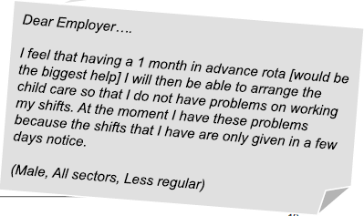
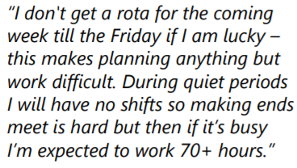
Shift variability means parents can’t plan
What does variability look like:
Not being able to finish on time, shifts changed at short notice, given their rota less than a week ahead of time, requests for overtime
26% of young working parents have had their shifts changed at short notice
19% of parents being given their rota less than a week in advance
Notes:
Shift variability/chaning working hours is a major problem that was flagged up
How is it possible to organise childcare – either through informal or formal networks
11% of those surveyed found that there hours were “extremely changeable” – n – page . 10 on the scale. Page 43 of the data table
Some sectors are affected much worse – hospitality for example

Slide 8
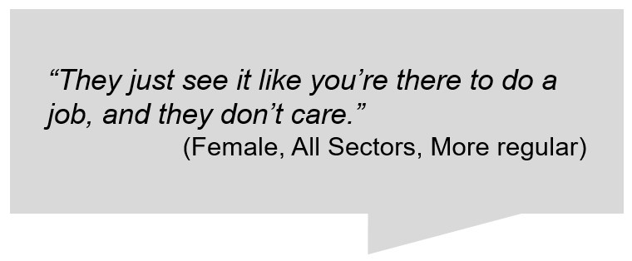
Employer indifference
Employers are not speaking to their staff about childcare needs. They’re not keeping up with changing attitudes amongst young parents.
Nearly a quarter (24%) of young parents in our survey did not feel that their employer does anything to accommodate their childcare needs.
51% of young parents have an employer who has never spoken to them about policies that exist to help them better balance work with childcare

Slide 9
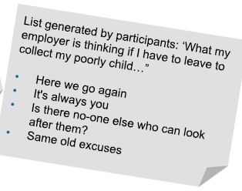
Stigma of flexibility and repercussions of asking for support
Parents are afraid to ask for help – for well founded reasons!
Over a third of young parents felt stigmatised at work as a result of needing flexibility to help manage childcare
42% of young parents feel penalised at work when they need flexibility:
Fewer hours
Worse shifts
Loss of job
Notes:
Stigma of asking for flexibility but then also real consequences for some parents who do ask

Slide 10
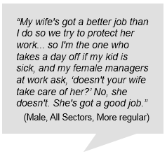
The fatherhood penalty
Gender stereotypes are still rife in the workplace. Young fathers’ attitudes have shifted significantly over the last decade – employers need to catch up.
57% of fathers have employers who have never spoken to them about better work life balance policies
48% of men feel guilty when they bring up childcare issues at work
Less likely to use legal rights - flexible working and time off for dependents
Notes:
Frowned upon for fathers to take leave
Working families – Modern Index report - nearly half of working fathers want to downshift into a less stressful job because they can’t balance the demands of work and family life. 7 out of 10 fathers consider flexible working needs before changing jobs
Bullet point 2 – data tables 91

Slide 11
Vindictive behaviour from line managers
Line managers can often exacerbate the problems that young parents face
Last minute shift changes, breaching confidentiality, and creating an atmosphere of fear
Line managers using disciplinary and health monitoring procedures against staff who had taken absences because of children’s sick days.
Notes:
Some line mangers will take active steps to make managing childcare more difficult.
This type of behaviour was prevalent in large retail sites and “in home social care” sector.

Slide 12
Most young parents (58%) feel they know little or nothing about what legal rights they have at work to help them balance work with childcare
63% knew little or nothing of right to unpaid parental leave
43% knew little or nothing of the right to request flexible working
50% knew little or nothing of right to time off for dependents
67% of young parents working part time say they know little or nothing about their rights.
Notes:
Many young parents showed concern that exercising these rights would negatively impact them at work. They felt it could jeopardise their job security if their manager viewed them as unreliable or a trouble maker. There was also concern that it could jeopardise their relationships with their colleagues who may perceive them to be getting special treatment.

Slide 13
Coping strategies have a time and financial penalty…
29% of parents have used annual leave, in the last 12 months, to cover a sickness day for a child
24% of young parents have taken unpaid leave, in the last 12 months, to cover a sickness day for a child
33% of parents have used a sick day, in the last 12 months, when it was their child who was sick and needed looking after...
Income is covered
Not asking for something for the kids

Slide 14
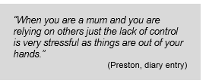
Impact on young parents
Impact on health - feelings of anxiety, stress, tiredness and guilt
Personal relationships damaged due to relying on informal networks
Reputation tarnished at work, for example, taking sick days to look after child
Impact on time – holiday leave being used to look after sick children
Impact on income – 24% asked to take time off with no pay at short notice, 10% incurred penalty fees for picking up children late
Notes:
Another quote here

Slide 15
Working practices
Shift variability
Notice of shifts at least one month in advance
Compensation for shift cancellation
Non contracted hours
Premium rate of pay for non guaranteed hours

Slide 16
Cultural shift
Promotion of business case benefits to employers
Campaigns to raise awareness of employment rights – Taylor review
Union strategies to negotiate policies and change culture in workplaces
Make it acceptable to use employment rights – lever to change culture

Slide 17
Enhancing employment rights
Unpaid parental leave
Paid leave
Piecemeal
Less notice period required
Right to request flexible working
Temporary change to terms and conditions
Right to time off for dependents
Period of paid leave

Slide 19
Gender Pay Gap Information Regulations
Matt Creagh

Slide 20
Overview
The regulations requires employers with 250 or more employees to publish statutory calculations every year showing how large the pay gap is between their male and female employees.
Public – from 31/03/2017
Private – from 06/04/2017

Slide 21
Who do the Regulations apply to?
Employers with over 250 relevant employees*
(This is determined by a “snapshot” taken on 05/04/17 – private sector)
(This is determined by a “snapshot” taken on 31/03/17 – public sector)
Private, Public, Voluntary
In companies with a group structure, each legal entity will need to report its data.
Public sector organisations within scope – Schedule 2 of legislation
http://www.legislation.gov.uk/uksi/2017/353/schedule/2/made

Slide 22
*Who is a relevant employee?
Section 83 of the Equality Act
Contract of employment/Apprentices/Contract to do work personally
ZHC and casualised contracts included
Agency workers not included as they are employed by agency
Those on the full pay rate
Employees on reduced rates of pay while on maternity leave or sick leave are excluded – Section 1 (2) bullet point 3

Slide 23
What has to be reported?
Difference between male and female employees in:
Average hourly pay
Median hourly pay
Average bonus pay (over a year – reg 10, (2))
Median bonus pay
% of male and female employees paid a bonus
% of male and female employees in each quartile

Slide 24
Reporting – how often and when?
Every year
Within 12 months of the “snapshot” date

Slide 25
How is “ordinary” pay defined?
Basic pay
Allowance
Pay for piecework
Leave pay (AL, ML, PL, Ad. L, Par. L, SPL)
Shift premium pay

Slide 26
What is not included in pay definition?
Overtime pay
Redundancy or termination pay
Pay in lieu of leave
Benefits in kind

Slide 27
How is bonus pay defined?
Money, vouchers, securities, security options, interests in securities
Payment linked to profit sharing, productivity bonus, PRP, incentive or commission pay

Slide 28
How to calculate hourly pay?
Add up ordinary and bonus pay during the “pay period”
(Pay period is the normal frequency with which the person is paid at the time of the “snapshot”, i.e. weekly/monthly).
Bonus pay is pro rata’d to fit the pay period
Multiply this amount by 7 then divide by the number of days in “pay period”.
Divide this figure by number of working hours in the week.
(Working hours are normal contractual hours or an average of the hours in the last 12 weeks where the person has worked – weeks with no hours do not count in the 12 weeks).
Month has 30.44 days. A year is 365.25

Slide 29
Worked example
£2000 per month. £5000 bonus in the year.
Total amount is £2000 + (£5000/365.25)x30.44) £416.70 = £2416.70
(2416.70 x 7 / 30.44) = £555.75
Divided by 40 hours in the working week.
£13.89

Slide 30
Where and how is the info published?
Accompanied by a statement verifying it is correct, from a senior official (director, partner, governor etc.)
Not required for public sector
Published on the website – accessible to employees and public
Must stay on the website for three years
Published on a government website

Slide 31
Future review/evaluation
Review must take place within 5 years of 06/04/17

Slide 32
Benefits
Greater transparency
Information for trade union negotiations
Negotiating levers
Consumer pressure
Impact on recruitment and retention

Slide 33
Weaknesses
Thresholds too high
No sanctions
Not an equal pay audit

Slide 34
Union case studies
Prospect – Met Office
Unite - Barclays
Notes:
Case study - narrowing the gender pay gap
Following a successful negotiation by Unite the union, Barclays eliminated the lowest pay grade in its bank branches, giving around 6,500 staff – 80% women, and 50% part time workers - an immediate and significant pay rise as they moved into the next pay scale. More recent pay negotiations - an increase in the minimum pay rate for each grade - gave these staff a further decent pay rise.
This promotion recognised and rewarded bank branch staff for the increases in their workloads and the changing roles. A significant number of women workers benefitted, and the bank’s gender pay gap narrowed as a result – good for the employer, as well as for the workers.
A deal has been struck to end the long standing gender pay gap at the Met Office thanks to a plan agreed by Prospect union and management at the world's leading weather forecaster.
With equal pay firmly in the spotlight across the UK, including the high profile case at the BBC, the landmark deal will see equal pay in place by 2020, with many staff set to receive better pay as a result. The package was announced today (Monday) and is now subject to a vote of staff at the Met Office – with Prospect recommending that its members vote to accept the offer.
Prospect have managed to negotiate this offer directly with the Met Office despite the government's cap on public sector pay.
Prospect first asked the Met Office to conduct an equal pay audit in 2015. It showed the pay gap between men and women was 10.7% and this meant senior female meteorologists earned about £7,000 less than male colleagues. This audit was followed by the launching of high profile legal case for equal pay by 77 women, supported by Prospect.

